Slide 1
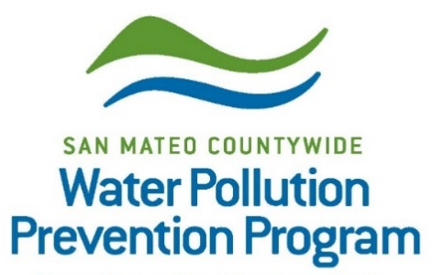
Pesticides Toxicity Control Requirements in the Municipal Regional Permit
Vishakha Atre
EOA, Inc.
Landscape IPM Workshop
June 5, 2024

Slide 2
Overview of Presentation
Background - Stormwater and Pesticides
Stormwater Regulations and the “Municipal Regional Permit (MRP)”
Pesticide Control Requirements in the MRP

Slide 3
Stormwater Pollution
Pollutants entering the storm drain system flow to local creeks and the Bay with no treatment
Everyday activities can cause stormwater pollution
Notes:
As you all know, storm drains are designed for flood control and carry rainwater to the nearest creek or the Bay. Water flowing into stormdrain is not treated to remove pollutants. Many acticities can cause stormrwater pollution – illegal dumpring, litter, sediment from construction sites, and pesticide applications where pesticides can flow into storm drains with rainwater or irrigation water.

Slide 4
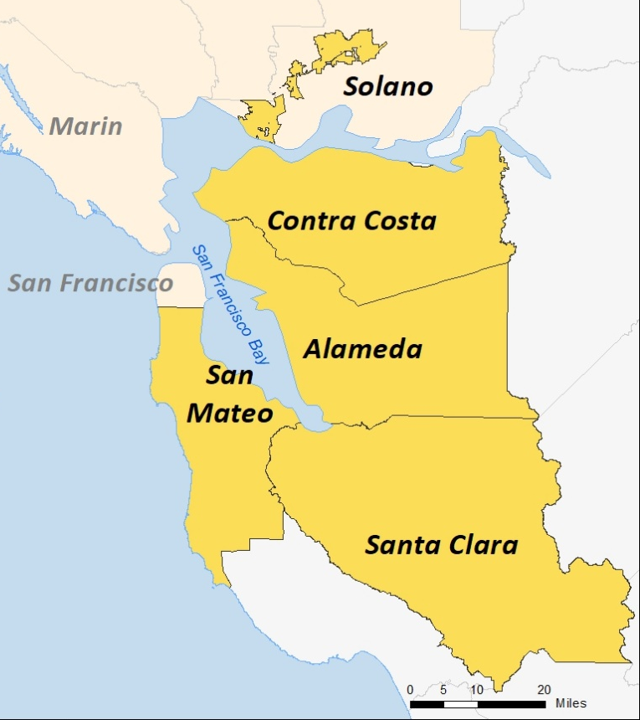
Municipal Regional Stormwater Permit (MRP)
San Mateo agencies (permittees) are part of the MRP that covers four Bay Area counties and parts of Solano
Includes requirements for controlling urban runoff pollutants – litter, sediment, metals, pesticides, etc.
Describes programs that permittees have to implement – inspections, public outreach, monitoring etc.
The San Mateo Countywide Water Pollution Prevention Program (SMCWPPP) assists San Mateo County municipal Permittees to implement MRP requirements
www.FlowstoBay.org
Notes:
In the San Francisco Bay Area, stormwater discharges are regulated by the SF Bay Regional Water Quality Control Board through the Municipalo Regional Storrmwater Permit or MRP.. All cities and towns in San Mateo are covered by the permit. The permit covers four Counties and two agencies in Solano.
SMCWPPP is a coalition of all cities and towns in San Mateo County, the County of San Mateo, and Flood Control District.

Slide 5
MRP Applicable Provisions
Topic Specific
Pollutant Specific
Monitoring/Reporting
C.2 Municipal Operations
C.3 New Development and Redevelopment
C.6 Construction Site Controls
C.7 Public Information and Outreach
C.17 Unsheltered Homeless Populations
C.4 Industrial/ Commercial Site Controls
C.5 Illicit Discharge Controls
C.15 Exempted and Conditionally Exempted Discharges
C.13 Copper Controls
C.14 Bacteria Controls
C.10 Trash Load Reduction
C.9 Pesticides Toxicity Control
C.11/12 PCB and Mercury Controls
C.8 Water Quality Monitoring
C.21 Asset Management
C.20 Cost Reporting
Notes:
MRP has Provisions with requirements related different municipal programs, pollutants of concern, monitoring and reporting
We are focused today on training topics in Provision C.9…

Slide 6
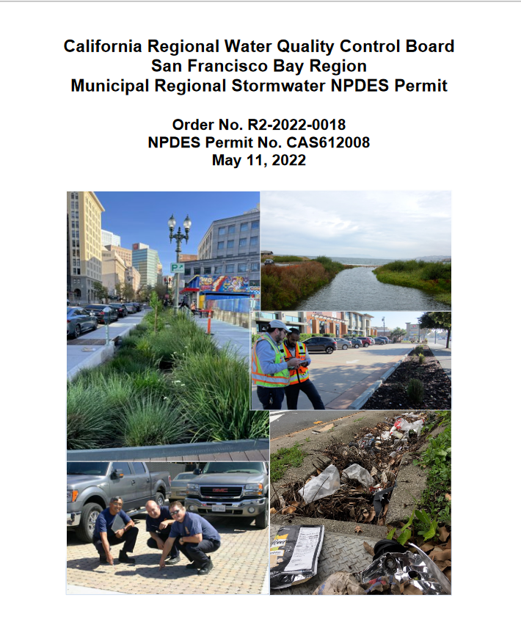
MRP Provision C.9
Provision C.9 of the MRP requires municipal agencies to implement a pesticides control program to help reduce pesticide discharges in stormwater runoff
Implementation guidance is provided through the SMCWPPP Parks Maintenance and IPM Work Group
MRP 3.0 was adopted on May 11, 2022
Notes:
Pesticide Toxicity Control requirements are listed in provision C.9 of the permit. And Implementation Guidance is provided through the Parks Maintenance IPM Work Group. It meets only a couple times every year, and we are planning to meet next in Fall..

Slide 7
MRP Provision C.9
Implement IPM Policy and Standard Operating Procedures
Ensure staff and contractors implement IPM Policy and SOPs
Track and report quantities pesticides of water quality concern in the Stormwater Annual Report
Implement and report two IPM Strategies in each Stormwater Annual Report
Notes:
All Permittees have an IPM policy in place and are required to implement IPM techniques for pest management on municipal properties. Municipal staff and contractors are required to follow IPM practices. Pesticides can be used, but you may need to document that other IPM techniques did not work. Track and report pesticide of concern – on the next slide I will provide a list of these pesticides of concern. You also have to implement and report on a two IPM tactics that were used in the reporting year.
SOPs, approve pesticides before use, have meetings/regular communications.

Slide 8
Pesticides of Concern
Many commonly used pesticides are known to negatively impact water quality in urban creeks.
Active ingredients listed in the MRP as pesticides of concern:
Diuron
Indoxacarb
Fipronil
Diamides
Organophosphates
Pyrethroids – bifenthrin, cyfluthrin,etc.
Carbamates
Neonicotinoids
Notes:
The permit identifies these active ingredients as pesticides of concern as these are impacting the water quality in local creeks and the San Francisco Bay. The Water Board requires that permittees report the quantity of these pesticides used in each Annual Report. Many permittees do not allow the use of these active ingredients on municipal properties so make sure you check your agency’s IPM policy to see what it says.
diamides (chlorantraniliprole and cyantraniliprole); diuron, fipronil and its degradates; indoxacarb; organophosphorous insecticides (chlorpyrifos, diazinon, and malathion); pyrethroids (metofluthrin, bifenthrin, cyfluthrin, beta-cyfluthrin, cypermethrin, deltamethrin, esfenvalerate, lambda-cyhalothrin, and permethrin); carbamates (e.g., carbaryl and aldicarb); and neonicotinoids (e.g., imidacloprid, acetamiprid, and dinotefuran).

Slide 9
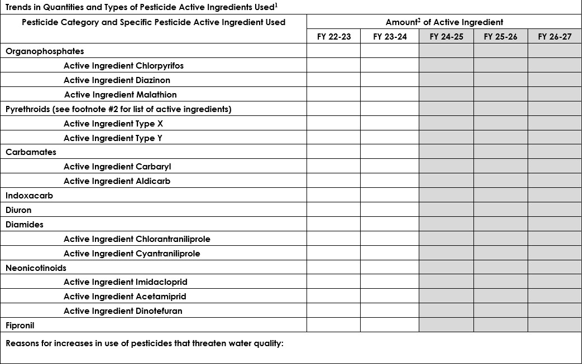
Notes:
All Permittees have an IPM policy in place and are required to implement IPM techniques for pest management on municipal properties. Municipal staff and contractors are required to follow IPM practices. Pesticides can be used, but you may need to document that other IPM techniques did not work. Track and report pesticide of concern – in a couple slides I will provide a list of these pesticides of concerns. You also have to implement and report on a two IPM tactics that were used in the reporting year.
SOPs, approve pesticides before use, have meetings/regular communications.

Slide 10
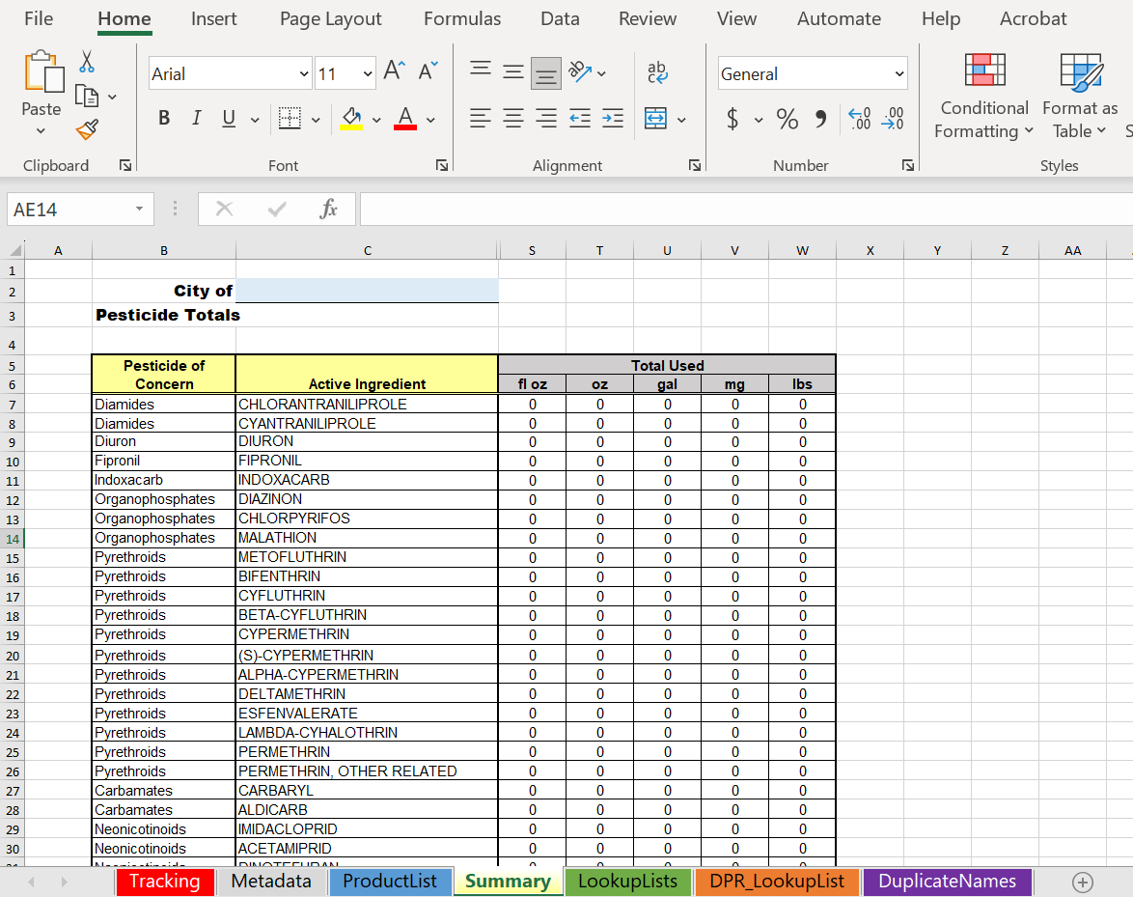
SMCWPPP
Pesticide Tracking Tool
Notes:
All Permittees have an IPM policy in place and are required to implement IPM techniques for pest management on municipal properties. Municipal staff and contractors are required to follow IPM practices. Pesticides can be used, but you may need to document that other IPM techniques did not work. Track and report pesticide of concern – in a couple slides I will provide a list of these pesticides of concerns. You also have to implement and report on a two IPM tactics that were used in the reporting year.
SOPs, approve pesticides before use, have meetings/regular communications.

Slide 11
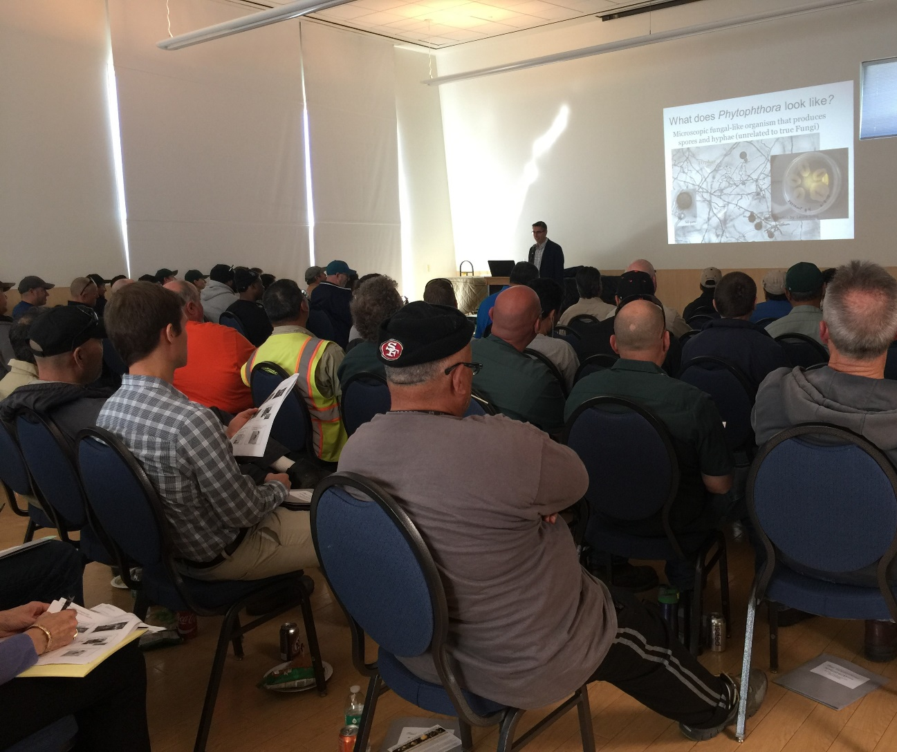
MRP Provision C.9
Municipal Staff Training
Provide IPM training to staff that apply pesticides
Annually, report number of these staff trained
Municipal Contractors
Require contractors to implement IPM
Monitor contactor activities to ensure compliance

Slide 12
MRP Provision C.9
Work with Regulatory Agencies
Encourage them to include water quality impacts in the pesticide registration process
Coordinate with Ag. Commissioners
Report violations
Obtain advice
Conduct Evaluation
Evaluate municipal pesticide control activities
Report with FY 24-25 Annual Report

Slide 13
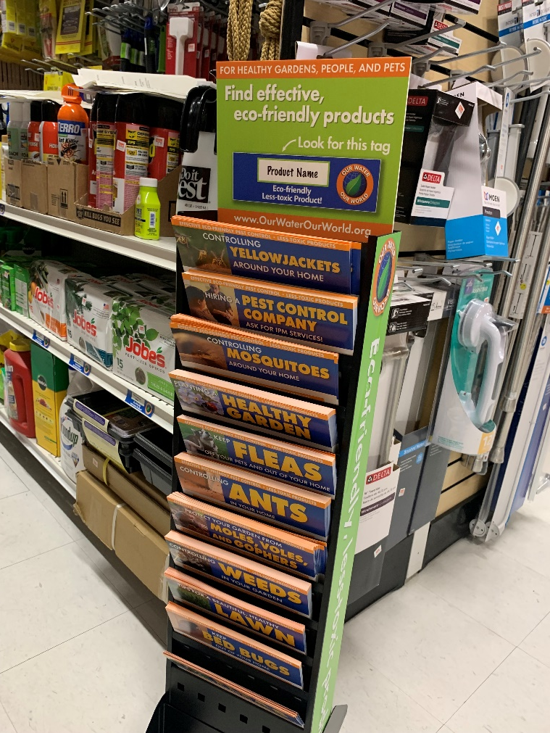
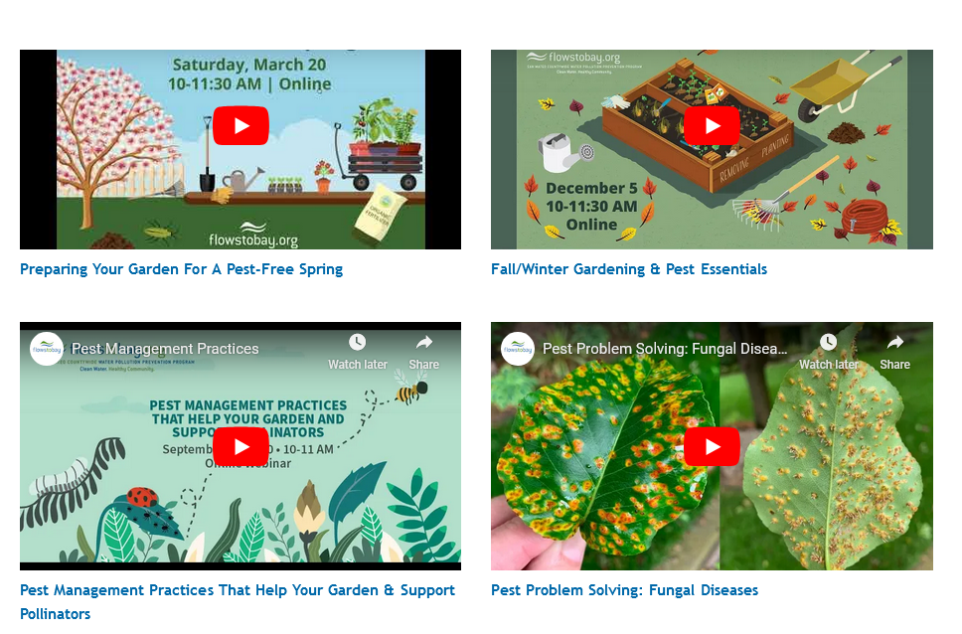
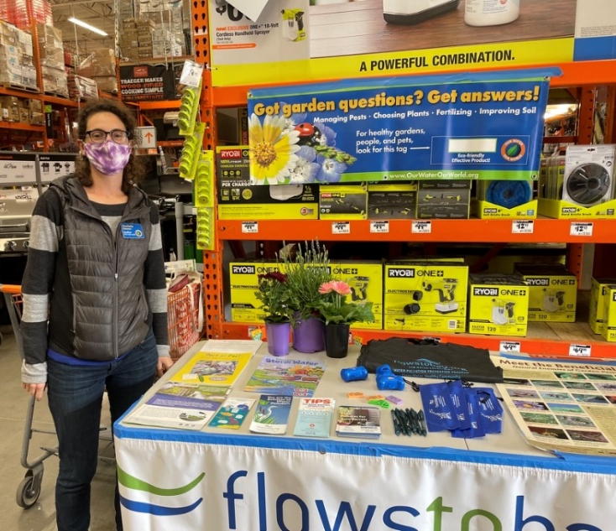
MRP Provision C.9
Conduct Public Outreach – FlowsToBay.org
Webinars
Point-of-purchase outreach

Slide 14
For more information…
www.FlowsToBay.org
Vishakha Atre
EOA, Inc.
408-720-8811 x3
vatre@eoainc.com

